Slide 1


Slide 2

Session 2. Building your first website
[90 min]

Slide 3
Session 2. Building your first website
a. Introduction + building blocks
[90 min]
[30 min]

Slide 4

Building blocks.

Slide 5
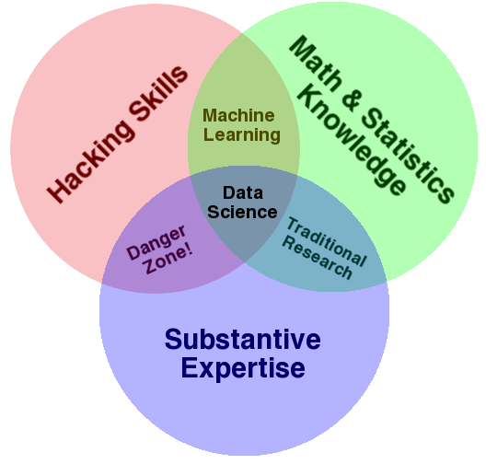
Data science.

Slide 6
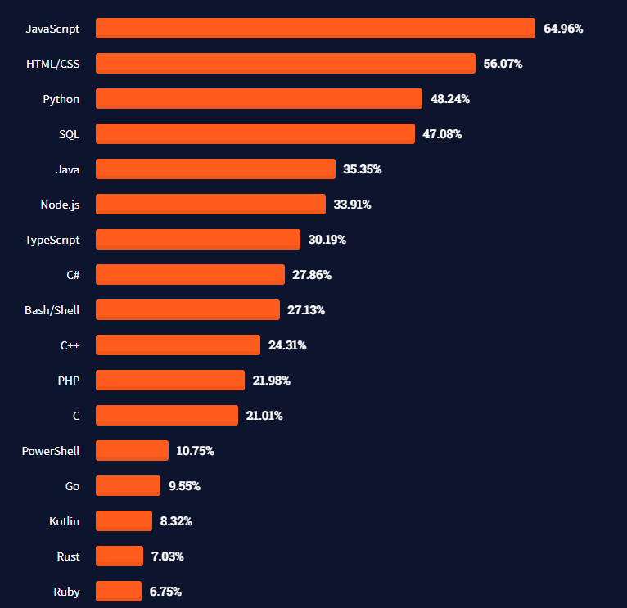
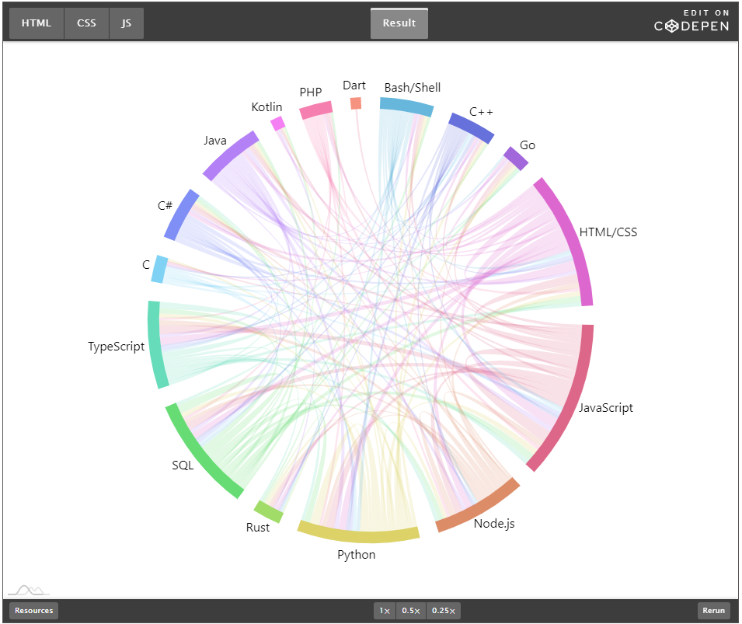
Most used languages, 2021.
https://insights.stackoverflow.com/survey/2021#technology-most-popular-technologies
https://stackoverflow.blog/2021/08/02/2021-stack-overflow-developer-survey-results/

Slide 7
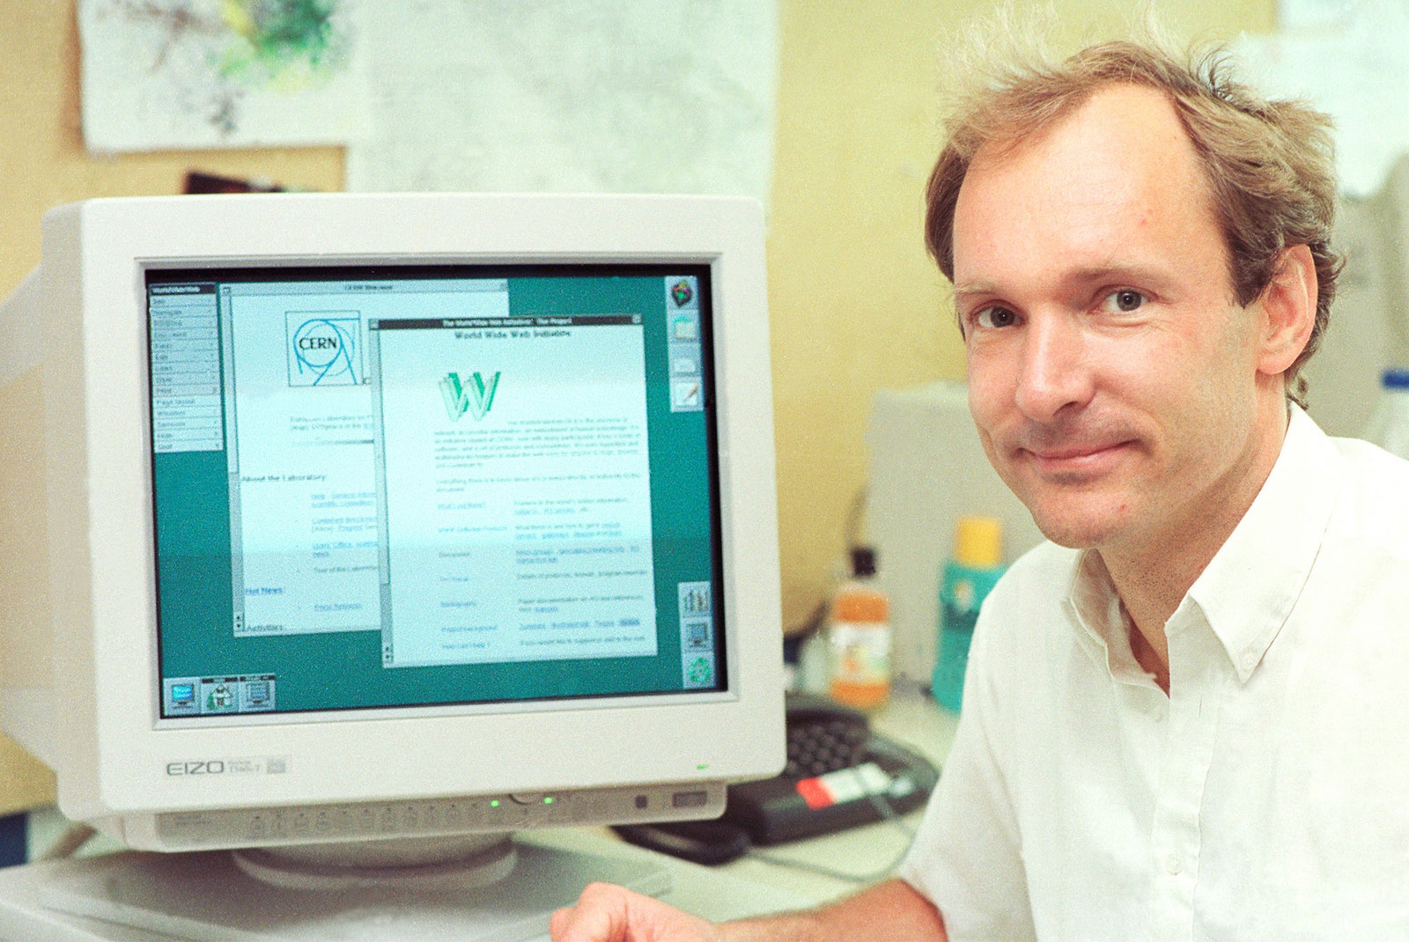
HTML.
HT. Hypertext.
As in http:// (Hypertext Transfer Protocol)
ML. Markup language
1993. Invented at CERN by Tim Berners-Lee.
1994. Dave Raggett (Hewlett Packard, Bristol), develops HTML+ and Arena browser.
1995. WC3 guidelines published, to end browser wars.
Big idea. The HT in the name is the big idea. There were lots of markup languages (SGML for example) but TBN idea was to link documents together, it added hyperlinks.
Tim Berners-Lee. Image: CERN
https://home.cern/science/computing/birth-web/short-history-web
https://www.vanityfair.com/news/2018/07/the-man-who-created-the-world-wide-web-has-some-regrets

Slide 8
HTML example.
<!DOCTYPE html>
<html>
<!-- Richard Davies, Data Science -->
<!-- Economics Observatory, Data Science for Public Policy -->
<head>
<title>Page Title</title>
</head>
<!-- The body contains thigs you see -->
<!-- Most elements both open and close, with the content in the middle -->
<!-- Indenting is optional, but helps with readability -->
<body>
<h1>My First Heading</h1>
<p>My first paragraph.</p>
</body>
</html>

Slide 9
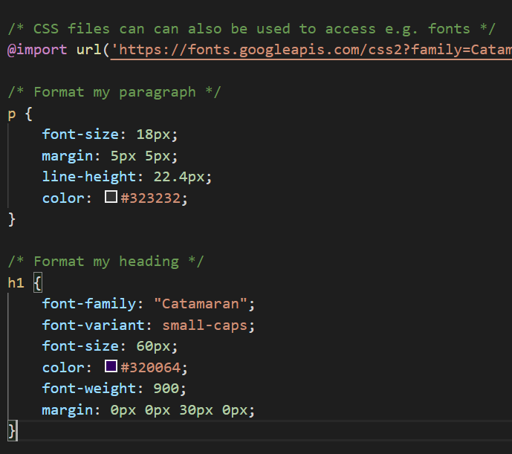

CSS.
Cascading Style Sheets
1994. First proposal – again at CERN.
Håkon Wium Lie, 12 December 1995
https://www.w3.org/Style/CSS20/history.html

Slide 10
Putting HTML and CSS together. To link your HTML page to a CSS file you specify the location in the head section of your page. <!-- Here is the head section --> <head> <title>Page Title</title> <!-- Link to my CSS file --> <link rel="stylesheet" href="firstExample.css"> </head> Your page will now have the styles set out in the CSS file.

Slide 11
JavaScript.
1995. JS launched by Netscape. Brief war with Microsoft before widespread adoption.
Brendan Eich. Key role in development of JS. Now used in almost all (>95%) of web sites.
Interactivity. JS allows us to make web sites interactive. Changing what the web site looks like and does in response to our choices.
In Data Science. Some uses of JS.
Fetching data. Grab data from another site, via an API, when you open you page.
Cleaning and manipulating data. Prepare and analyse the data for use in a chart or table.
Visualising data. Display the data in a way you wish. There are lots of charting “libraries” that do this. We will use two (Vega Lite and Charts.js).
Interactivity. Make visualisations interactive + sites fun and engaging.

Slide 12
JSON data.
JavaScript Object Notation. An important data type. Why use it?
It is the way computers share data.
Most importantly it is what many APIs will deliver – your data will arrive to you in this way.
It looks complicated at first, but is easy to convert into access, change and chart.
Formatted as key : value pairs (aka name : value pairs)
'{"name":“Richard", “kids":3, “team":“Manchester United”, “address”:null}’
Keys are strings, always in double quotes.
Values can be many things: string, number, arrays, objects.
Useful tools:
www.jsonlint.com. Test and format JSON.
JSON formatter. Chrome extension.

Slide 13
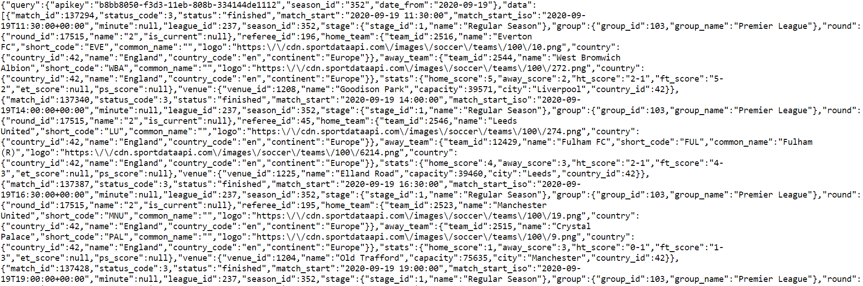
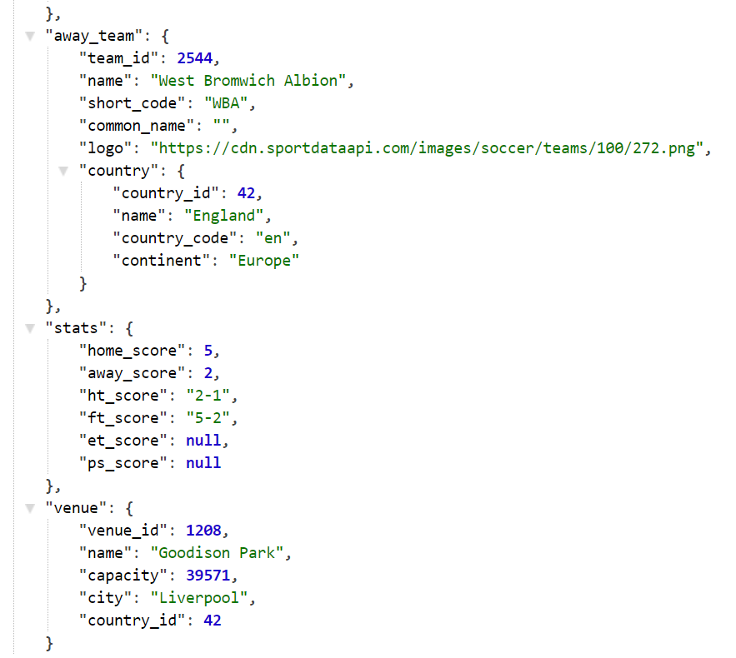
Raw.
Parsed.
API returns. The results of request to Sport Data API.

Slide 14
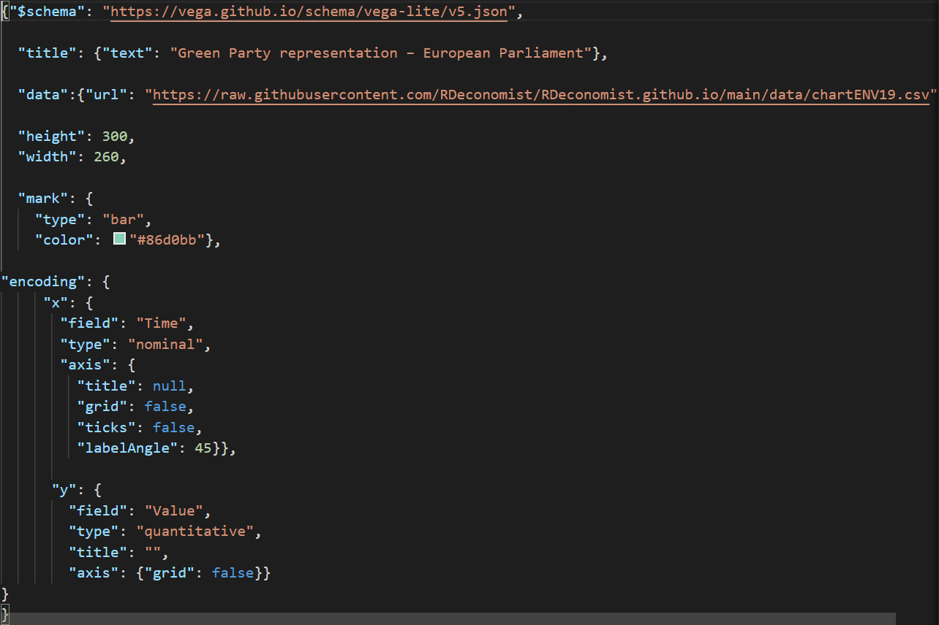
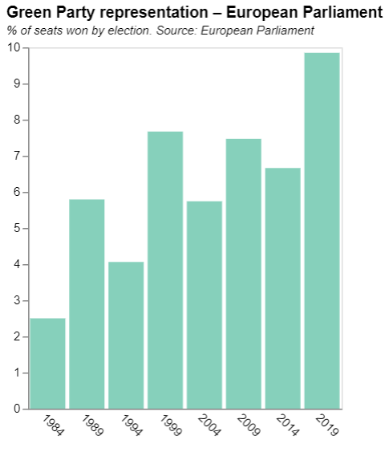
Charts as JSON.

Slide 16
Session 1. Building your first website
Code-along
[90 min]
[30 min]

Slide 17
Embedding charts.

Slide 18

Code-along.
Set up your GitHub pages site.
Enter your details https://tinyurl.com/DSPP2023.
Embed first two charts in your page.
Use examples in the GitHub folder /section1

Slide 19
CSS – updated to 3-tier format.
Edit your “index.css” file
Use ”exampleCharlie.css” file for inspiration
Link “index.css” to “index.html” using:
<link rel="stylesheet" href="index.css"> (inside html head)
Don’t forget to import chosen fonts into “index.html” and add font rules to “index.css”

